Slide 1


Amazon Customer Satisfaction and Loyalty: an ECSI Approach
Andrea Garcia Fernandez
Louis Delcour

Slide 2





Background
Marketing Research Context
Table of Contents
Methodology
Demographics
Findings
Conclusion and Recommendations

Slide 3

Amazon’s Mission and Vision Statement
Amazon is guided by four principles: customer obsession rather than competitor focus, passion for invention, commitment to operational excellence, and long-term thinking.
Vision Statement: “to be the Earth’s most customer centric company; to build a place where people can come find and discover anything they might want to buy online”

Slide 4
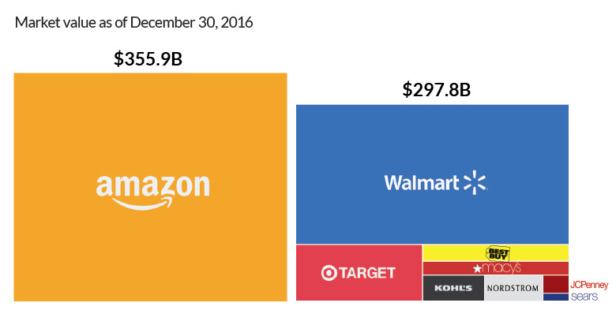
Background
Amazon Statistics:
Owns the largest piece of the online retail market share: 37.8 %
Total revenue in 2022: $514.36 B
Average daily sales revenue: $1.4 B
Gross profit: $256.202 B
310 million customers spread over 180 countries

Slide 5
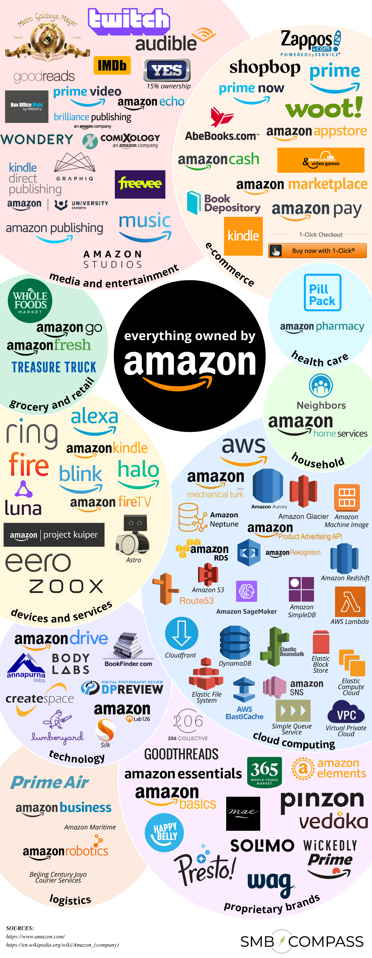

Everything owned by Amazon
Amazon reported more than $420 billion in total assets
In addition to their own proprietary cloud computing services and retail brands, there are many other Amazon owned companies:
Whole Foods
Audible
GoodReads
Prime Video
AWS
Kindle Store
Amazon Pharmacy
Notes:
https://companiesmarketcap.com/amazon/total-assets/

Slide 6


Marketing Research Context
Business Problem
Challenge: with a 37% market share in the competitive online retail space, there is a need to retain customers and attract new ones to prevent market share loss
Strategic Solution: leveraging loyalty as our compass, we investigate key attributes influencing customer commitment. These insights will be used to tailor Amazon’s marketing efforts.
Notes:
Source images : Powerpoint Stock Images

Slide 7
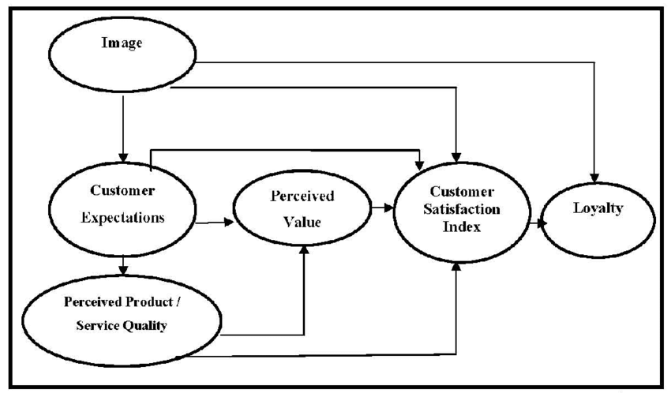
Methodology
Mixed method:
Qualitative analysis: 3 customer interviews
Quantitative analysis: survey (Qualtrics)
The European Customer Satisfaction Index (ECSI)
Endogenous Variables: variables influenced by other variables inside the model (Perceived value, customer satisfaction, loyalty)
Exogenous Variables: variables influenced by other variables outside the model (Image, customer expectations, perceived product, perceived service quality)
Variables used in this research:
Perceived Value
Customer Satisfaction
Loyalty

Slide 8
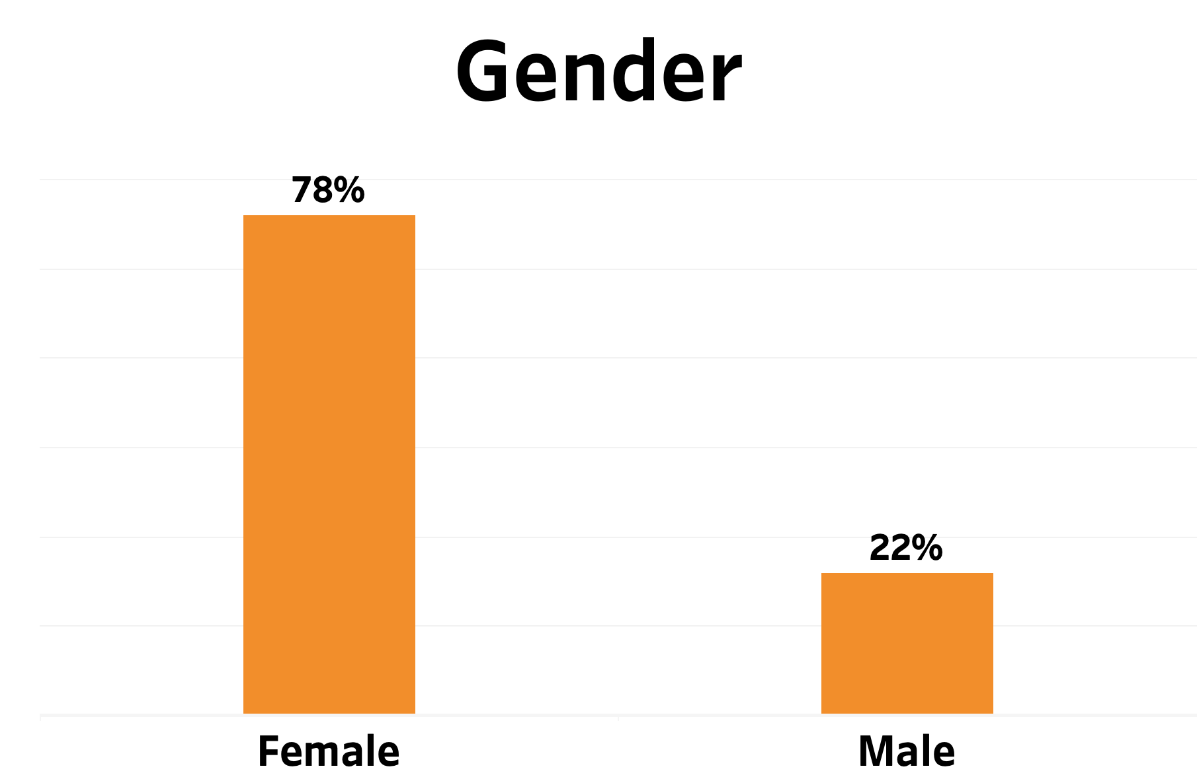
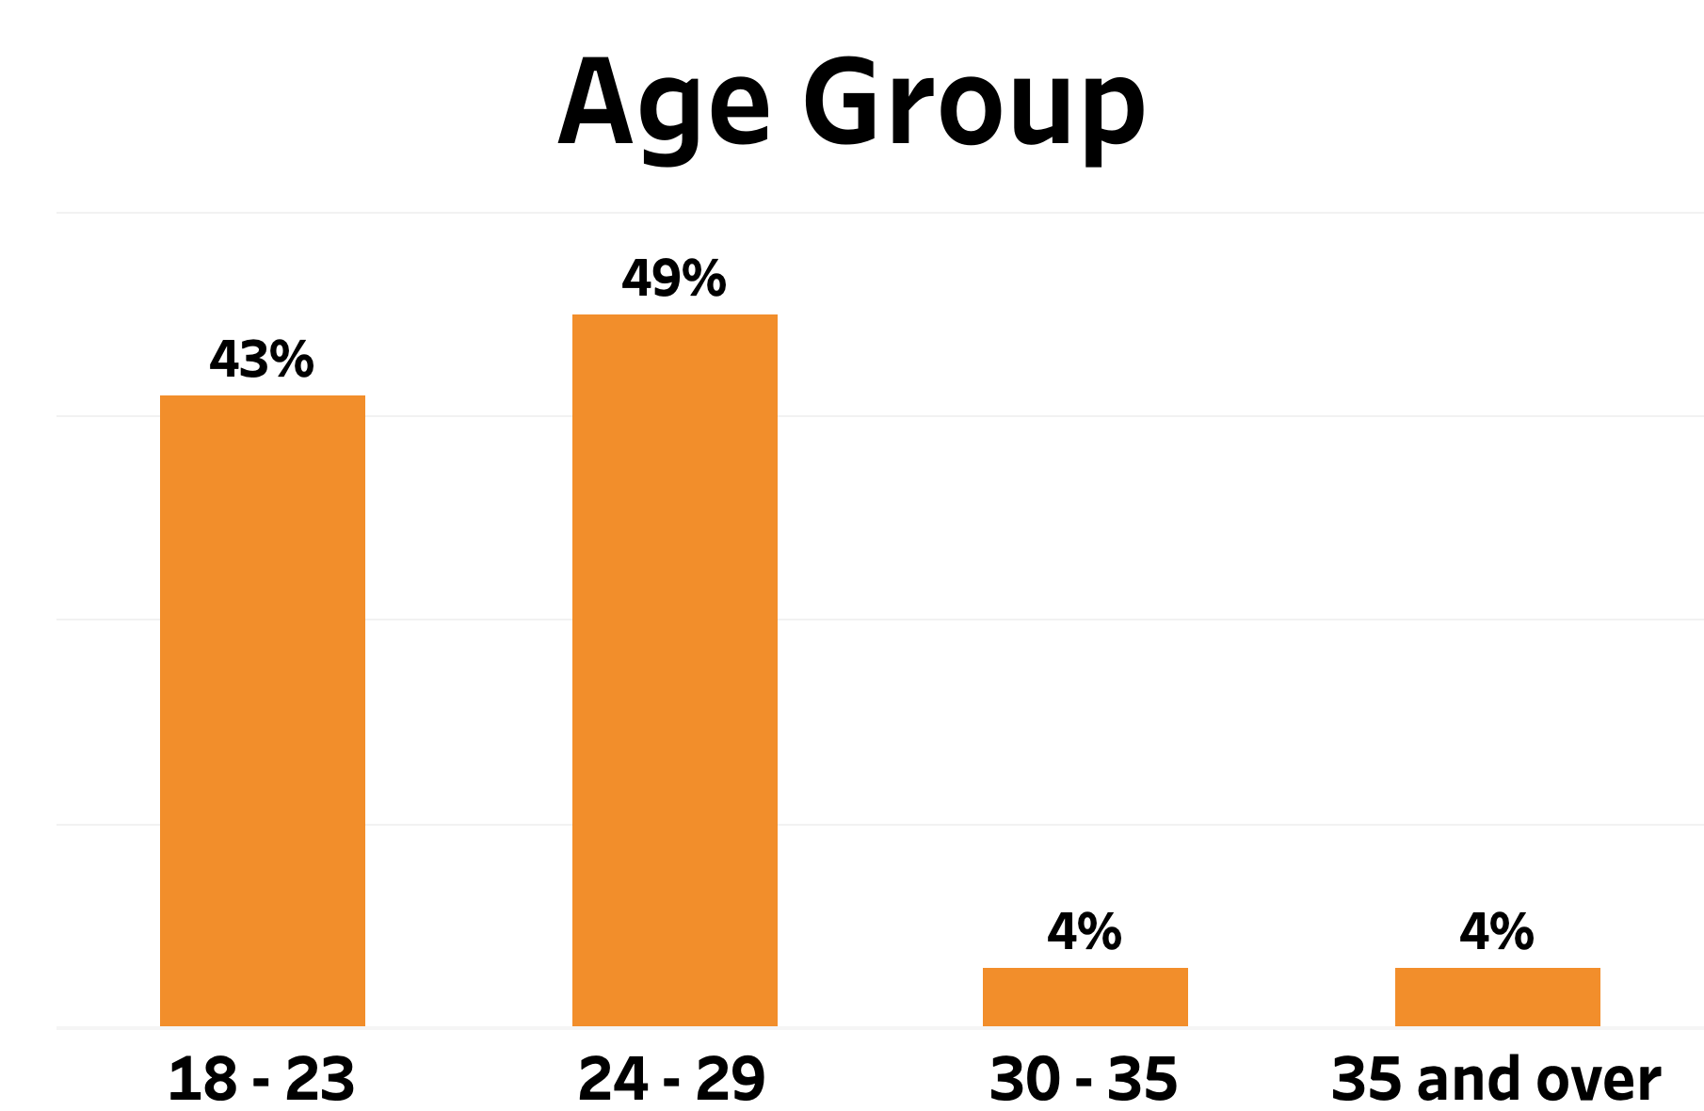
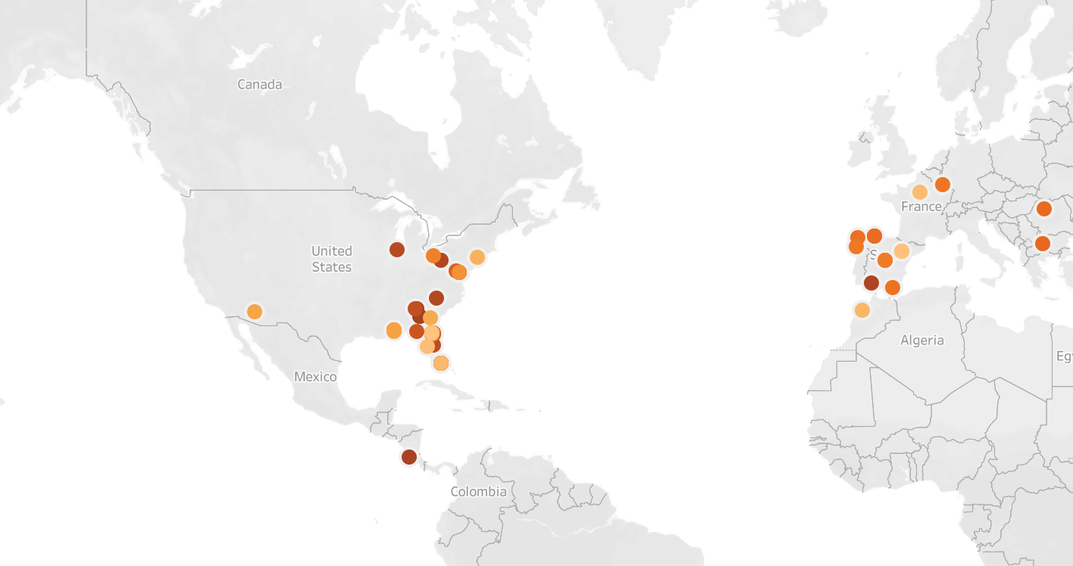
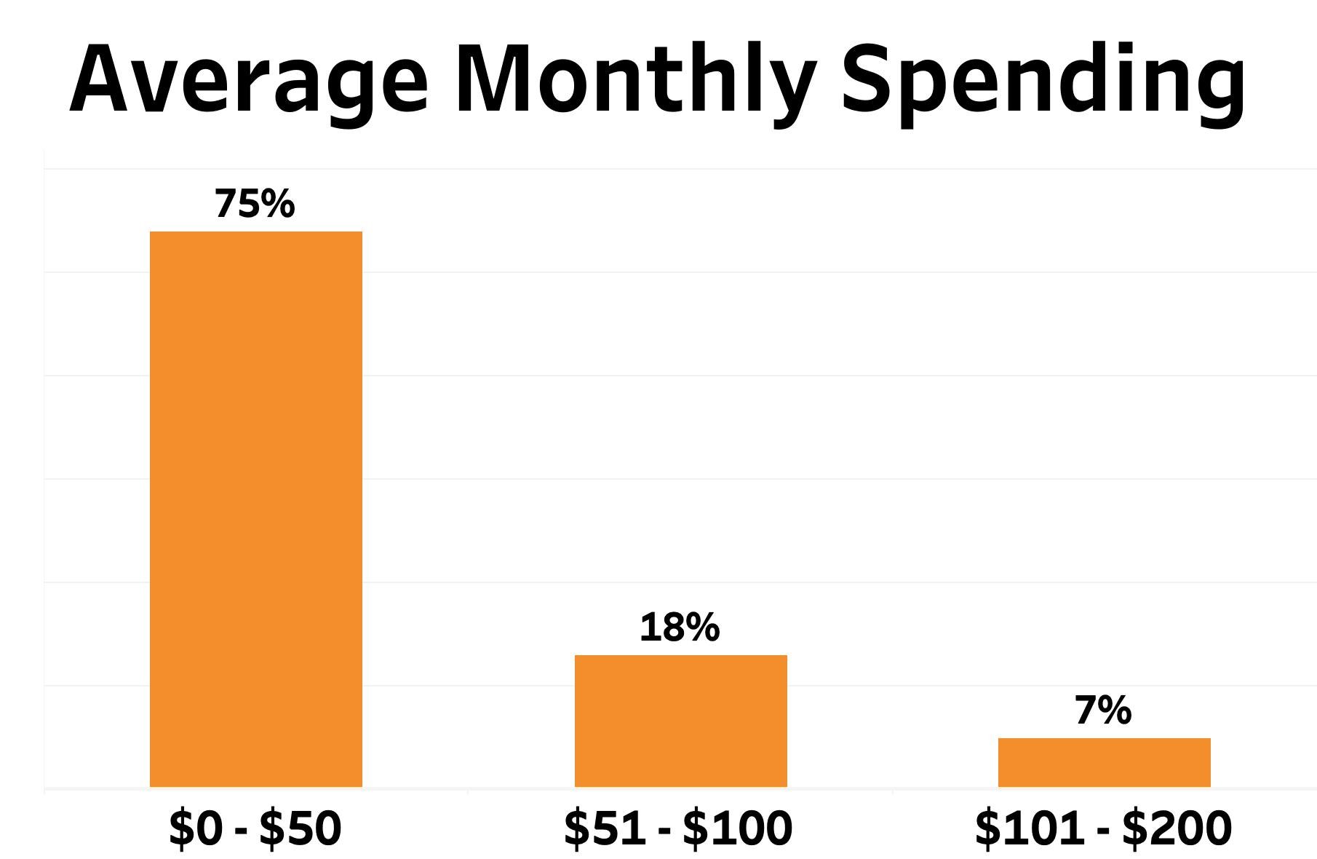
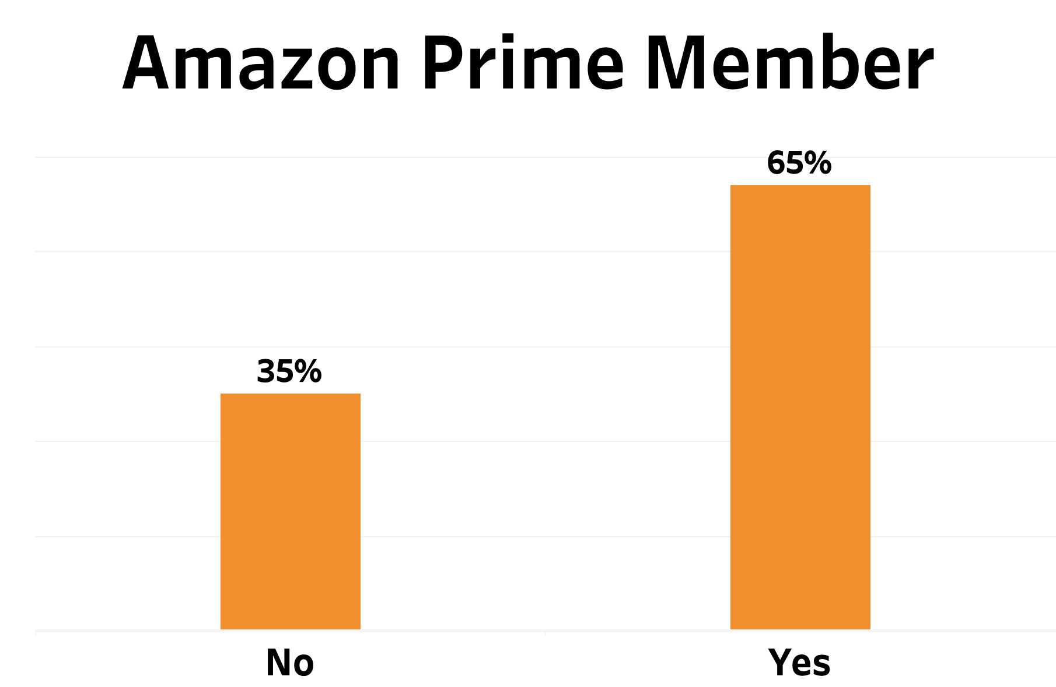
Sampling and Targeted Demographics
Sample size: 72
Sampling Technique: Random sampling

Slide 9
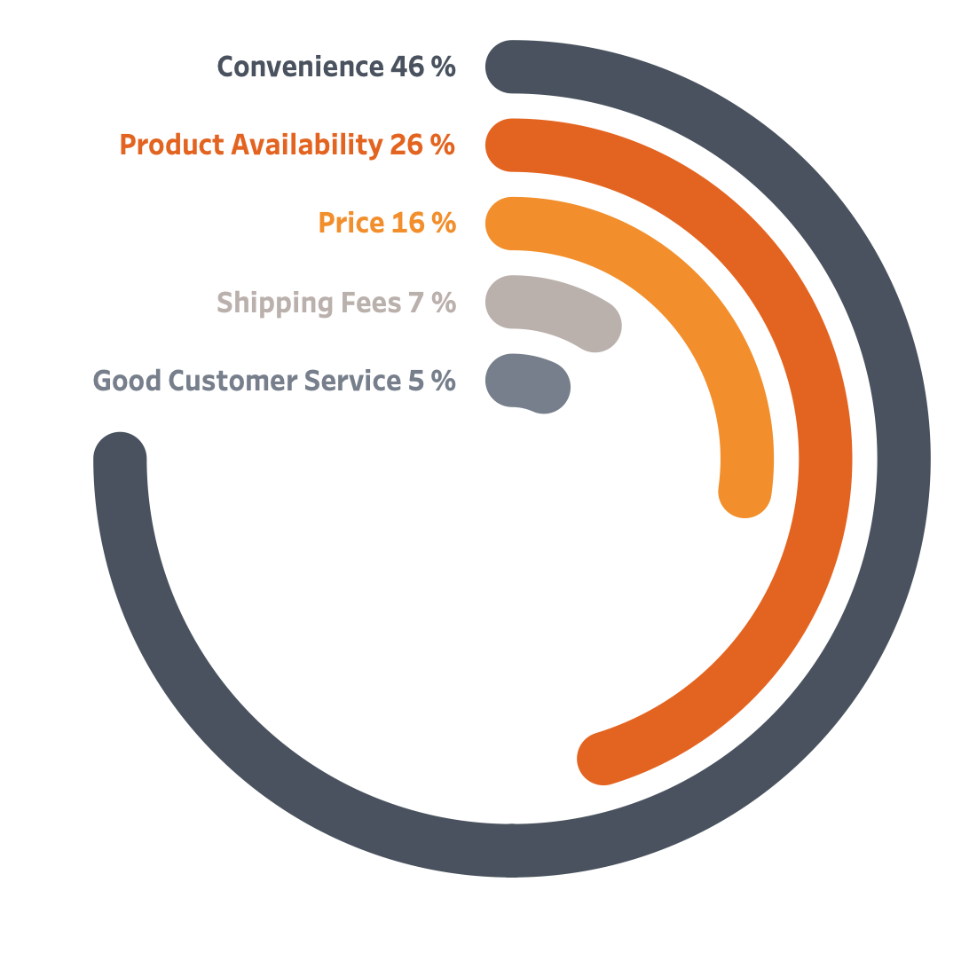
What Factor Contributes the most to Customer Satisfaction?

Slide 10

Qualitative Analysis Findings
Key Insights:
Fast shipping matters: “fast”, “delivery”, “first”
Building a strong brand: “brand”, “product”, “advantage”
Balancing cost and value: “price”, ”discount”, ”deal”, ”benefits”
Positive customer sentiment: “always”, ”everything”, ”really”, ”easy”
Aligning with Amazon’s mission: “people”

Slide 11




Qualitative Analysis Findings Continued
From transactional to transformational:
Simplified Amazon shopping experience: order, shipping, delivery
Continuously delivering positive experiences and exceeding customer expectations
Fostering customer relationships
Commitment to its customer-centric mission
Order
Shipping
Delivery

Slide 12
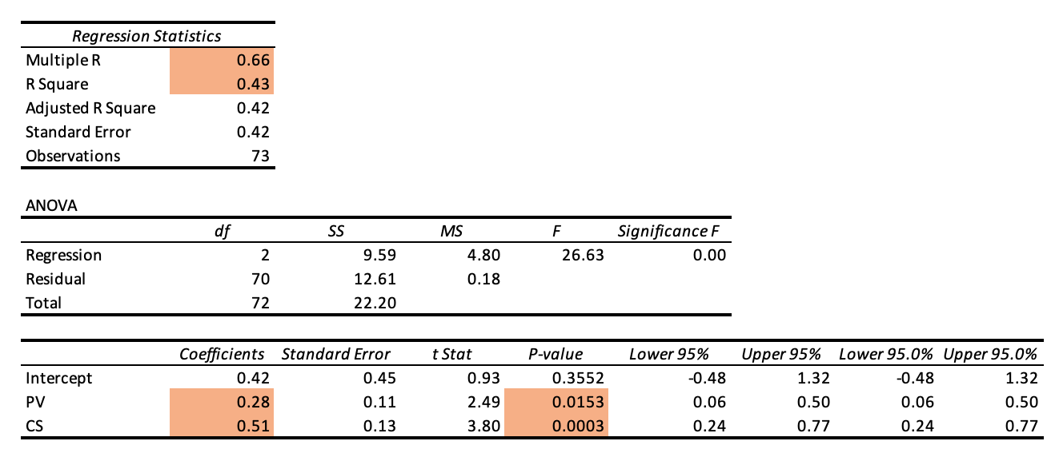
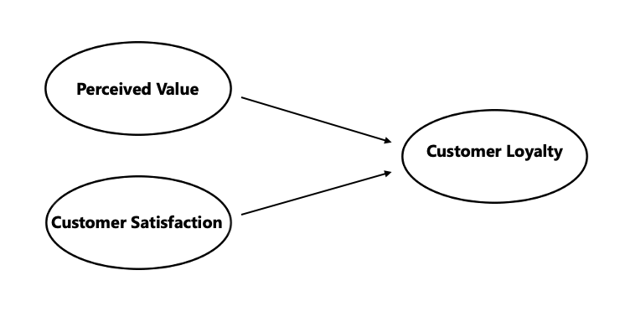
Quantitative Analysis Findings
p: 0.0153
p: 0.0003
Note: Significant p < 0.05

Slide 13
Quantitative Analysis Findings Continued
Item | Result
H₁: customer satisfaction has a positive and statistically significant impact on customer loyalty | Supported (p-value: 0.0153< 0.05)
H₂: perceived value has a positive and statistically significant impact on customer satisfaction | Supported (p-value: 0003 < 0.05)
Multiple R (0.66) | Moderately strong relationship
R² (0.43) | Loyalty is influenced by several complex and unobservable factors. Hence, the the low score
Coefficients (PV: 0.28, CS: 0.51) | Positive relationship

Slide 14
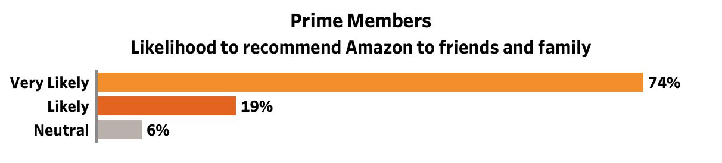
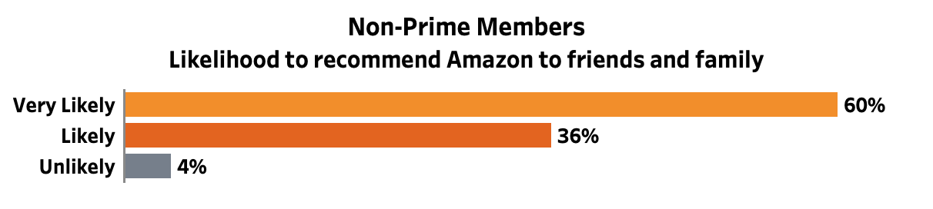
Quantitative Analysis Findings Continued
Prime Members are 14 % more likely to recommend Amazon to friends and family

Slide 15
Quantitative Analysis Findings Continued
98%
of participants are very satisfied or satisfied with their overall shopping experience
97 %
of participants are very likely or likely to repurchase in the future
96 %
Of participants strongly agree or agree that their orders are typically delivered within the estimated timeframe
89 %
of participants rate the quality of products given the prices they pay as excellent or good
39 %
of participants would not be willing to pay higher prices for Amazon

Slide 16
Further research other factors affecting loyalty
1
Recommendations
2
Increase Amazon Prime members
3
Gather and act on customer feedback
Notes:
Create new incentives for amazon prime members
Innovate with the goal of customer retention

Slide 17

Conclusion
Loyalty is a complex phenomenon impacted by several unobservable factors
Key loyalty driver: Customer Satisfaction
Effective customer-centric driven attitude

Slide 18
Q&A

Slide 19
References
Connolly, B. (2023, October 27). 2023 Amazon Statistics: Daily Sales, Revenue Growth & Users. Jungle Scout. https://www.junglescout.com/blog/amazon-statistics/
Desjardins, J. (2019, March 11). The extraordinary size of Amazon in one chart. Visual Capitalist. https://www.visualcapitalist.com/extraordinary-size-amazon-one-chart/#:~:text=It’s%20bigger%20than%20most%20brick%20and%20mortar%20retailers%20together&text=Amazon%20takes%20the%20cake%2C%20and%20its%20no%20contest.&text=However%2C%20it’s%20not%20enough%20to,market%20capitalization%20in%20the%20world.
Eurico, S., Oom do Valle, P., & Albino Silva, J. (2013). Satisfaction in tourism-related higher education: The graduates’ perspective. International Journal of Academic Research, 5(4), 35–49. https://doi.org/10.7813/2075-4124.2013/5-4/b.5
Gillman, M. (2023, February 7). Everything owned by Amazon. SMB Compass. https://www.smbcompass.com/everything-owned-by-amazon/
US About Amazon. (2020, September 18). Who we are: Amazon. US About Amazon. https://www.aboutamazon.com/about-us

